Slide 1
Error Detection and Correction
Chapter-10

Slide 2
Outline
Overview of Data Link Layer
Types of errors
Redundancy
Correction vs. detection
Coding

Slide 3
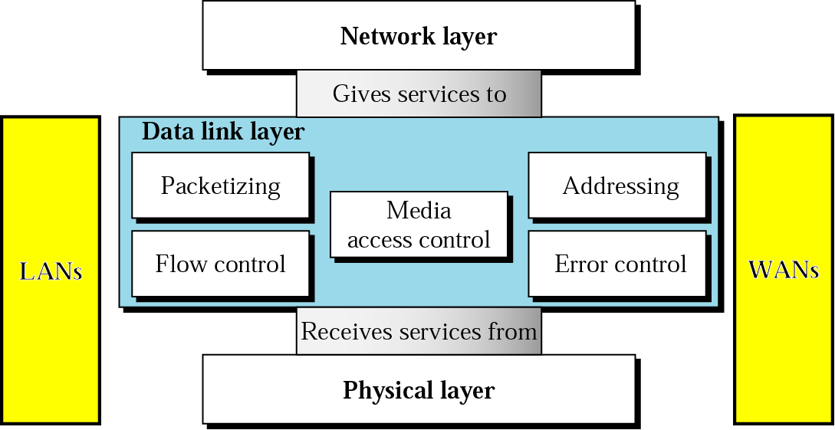
Data Link Layer

Slide 4
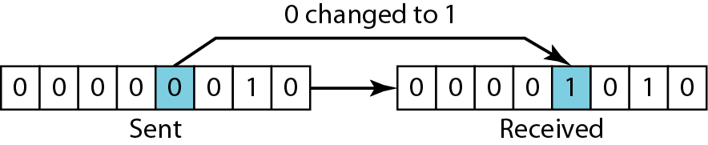
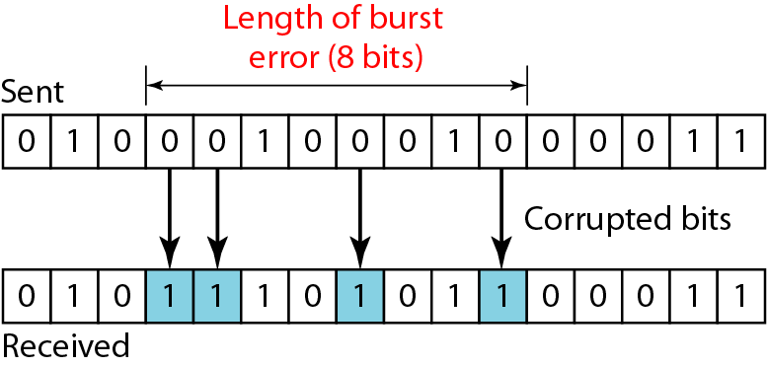
Types of Errors
Single-bit errors
Burst errors

Slide 5
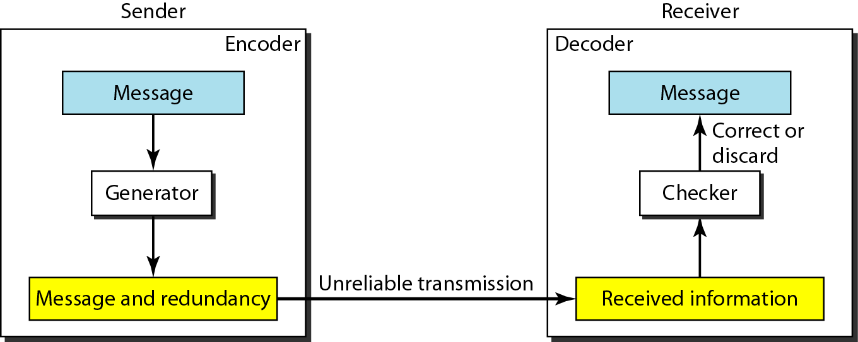
Redundancy
To detect or correct errors, redundant bits of data must be added

Slide 6
Detection VS Correction
In error detection, we are only looking to see if any error has occurred. The answer is a simple yes or no. We are not even interested in the number of corrupted bits. A single-bit error is the same for us as a burst error.
In error correction, we need to know the exact number of bits that are corrupted and, more importantly, their location in the message. The number of errors and the size of the message are important factors. If we need to correct a single error in an 8-bit data unit, we need to consider eight possible error locations; if we need to correct two errors in a data unit of the same size, we need to consider 28 (permutation of 8 by 2) possibilities. You can imagine the receiver’s difficulty in finding 10 errors in a data unit of 1000 bits.

Slide 7
Coding
Process of adding redundancy for error detection or correction
Two types:
Block codes
Divides the data to be sent into a set of blocks
Extra information attached to each block
Memoryless
Convolutional codes
Treats data as a series of bits, and computes a code over a continuous series
The code computed for a set of bits depends on the current and previous input

Slide 8
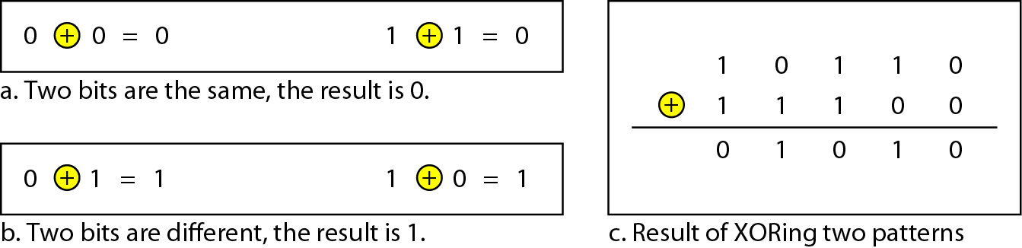
XOR Operation
Main operation for computing error detection/correction codes
Similar to modulo-2 addition

Slide 9
10-2 BLOCK CODING
In block coding, we divide our message into blocks, each of k bits, called datawords. We add r redundant bits to each block to make the length n = k + r. The resulting n-bit blocks are called codewords.
Topics discussed in this section:
Error Detection Error Correction Hamming Distance
Minimum Hamming Distance

Slide 10
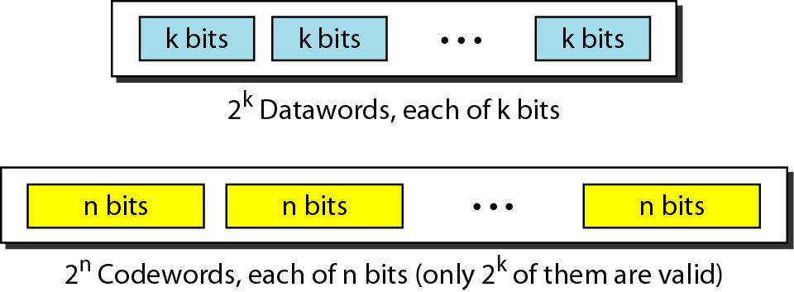
Figure 10.5 Datawords and codewords in block coding

Slide 11
Example 10.1
The 4B/5B block coding discussed in Chapter 4 is a good example of this type of coding. In this coding scheme, k = 4 and n = 5. As we saw, we have 2^{k} = 16 datawords and 2^{n} = 32 codewords. We saw that 16 out of 32 codewords are used for message transfer and the rest are either used for other purposes or unused.

Slide 12
Example: 4B/5B Block Coding
Data | Code | Data | Code
0000 | 11110 | 1000 | 10010
0001 | 01001 | 1001 | 10011
0010 | 10100 | 1010 | 10110
0011 | 10101 | 1011 | 10111
0100 | 01010 | 1100 | 11010
0101 | 01011 | 1101 | 11011
0110 | 01110 | 1110 | 11100
0111 | 01111 | 1111 | 11101
k = 5
r = ?
n = 4

Slide 13
Error Detection
Enough redundancy is added to detect an error.
The receiver knows an error occurred but does not know which bit(s) is(are) in error.
Has less overhead than error correction.

Slide 14
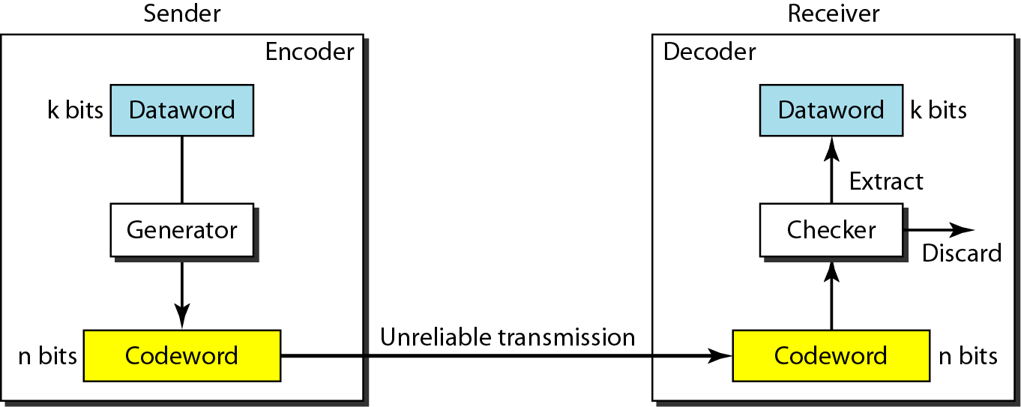
Figure 10.6 Process of error detection in block coding

Slide 15
Example 10.2
Let us assume that k = 2 and n = 3. Table 10.1 shows the list of datawords and codewords. Later, we will see how to derive a codeword from a dataword.
Table 10.1 A code for error detection (Example 10.2)

Slide 16
Example 10.2 (continued)
Assume the sender encodes the dataword 01 as 011 and
sends it to the receiver. Consider the following cases:
1. The receiver receives 011. It is a valid codeword. The receiver extracts the dataword 01 from it.
2. The codeword is corrupted during transmission, and 111 is received. This is not a valid codeword and is discarded.
3. The codeword is corrupted during transmission, and 000 is received. This is a valid codeword. The receiver incorrectly extracts the dataword 00. Two corrupted bits have made the error undetectable.

Slide 17

Note
An error-detecting code can detect only the types of errors for which it is designed; other types of errors may remain undetected.

Slide 18
Hamming Distance
Note
The Hamming distance between two words is the number of differences between corresponding bits.
10.

Slide 19

Example 10.4
Let us find the Hamming distance between two pairs of words.
1. The Hamming distance d(000, 011) is 2 because
2. The Hamming distance d(10101, 11110) is 3 because
10.

Slide 20
Note
The minimum Hamming distance is the smallest Hamming distance between all possible pairs in a set of words.
10.

Slide 21
Example 10.5
Find the minimum Hamming distance of the coding scheme in Table 10.1.
Solution
We first find all Hamming distances.
The d_{min} in this case is 2.
10.

Slide 22
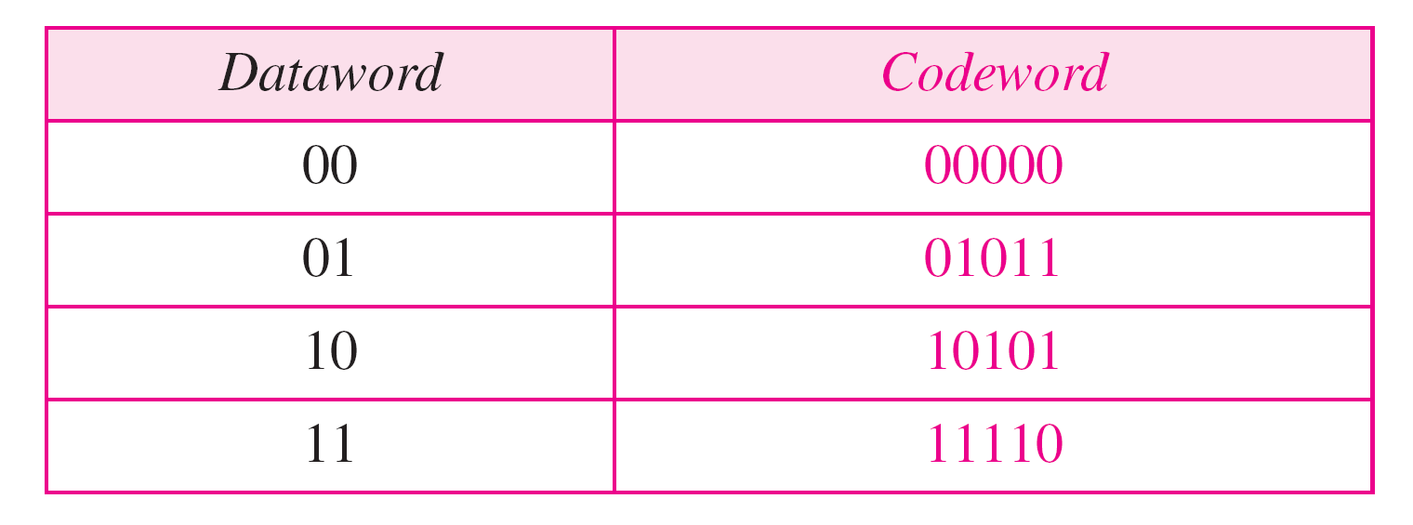
Example 10.6
Find the minimum Hamming distance of the coding scheme in Table 10.2.
Solution
We first find all the Hamming distances.
The d_{min} in this case is 3.
10.

Slide 23
Note
To guarantee the detection of up to s errors in all cases, the minimum
Hamming distance in a block code must be d_{min} = s + 1.
10.

Slide 24
Example 10.7
The minimum Hamming distance for our first code scheme (Table 10.1) is 2. This code guarantees detection of only a single error. For example, if the third codeword (101) is sent and one error occurs, the received codeword does not match any valid codeword. If two errors occur, however, the received codeword may match a valid codeword and the errors are not detected.
10.

Slide 25
Example 10.8
Our second block code scheme (Table 10.2) has d_{min} = 3. This code can detect up to two errors. Again, we see that when any of the valid codewords is sent, two errors create a codeword which is not in the table of valid codewords. The receiver cannot be fooled.
However, some combinations of three errors change a valid codeword to another valid codeword. The receiver accepts the received codeword and the errors are undetected.
10.

Slide 26
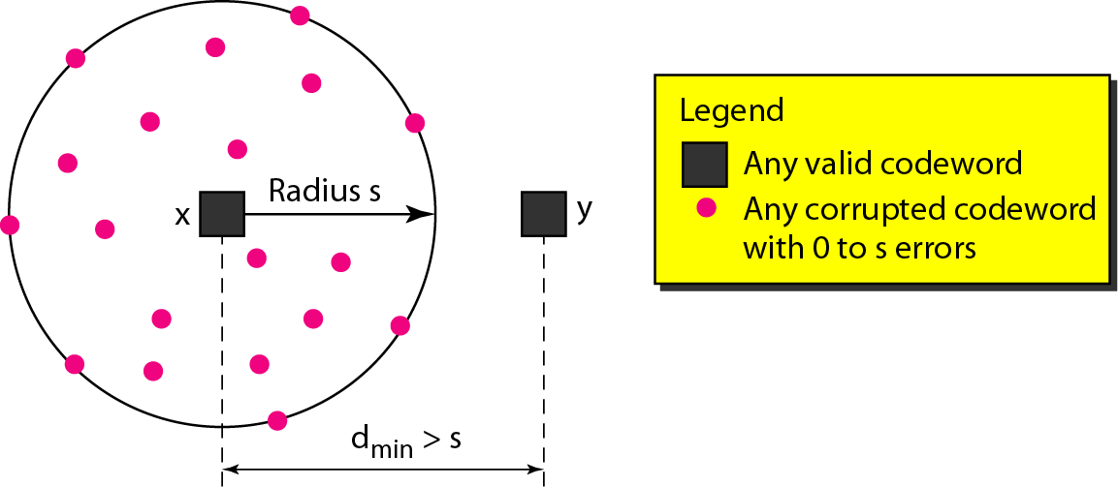
Figure 10.8 Geometric concept for finding d_{min} in error detection
10.

Slide 27
Note
To guarantee correction of up to t errors in all cases, the minimum Hamming distance in a block code must be d_{min} = 2t + 1.
10.

Slide 28
10-3 LINEAR BLOCK CODES
Almost all block codes used today belong to a subset called linear block codes. A linear block code is a code in which the exclusive OR (addition modulo-2) of two valid codewords creates another valid codeword.
Topics discussed in this section:
Minimum Distance for Linear Block Codes Some Linear Block Codes
10.

Slide 29
Note
In a linear block code, the exclusive OR (XOR) of any two valid codewords creates another valid codeword.
10.

Slide 30
Example 10.10
Let us see if the two codes we defined in Table 10.1 and Table 10.2 belong to the class of linear block codes.
1. The scheme in Table 10.1 is a linear block code because the result of XORing any codeword with any other codeword is a valid codeword. For example, the XORing of the second and third codewords creates the fourth one.
2. The scheme in Table 10.2 is also a linear block code. We can create all four codewords by XORing two other codewords.
10.

Slide 31
Example 10.11
In our first code (Table 10.1), the numbers of 1s in the nonzero codewords are 2, 2, and 2. So the minimum Hamming distance is d_{min} = 2. In our second code (Table 10.2), the numbers of 1s in the nonzero codewords are 3, 3, and 4. So in this code we have d_{min} = 3.
10.

Slide 32
Common Detection Methods
Parity check
Cyclic Redundancy Check
Checksum

Slide 33
Parity-check code
The most familiar error-detecting code is the parity-check code.
This code is a linear block code.
In this code, a k-bit dataword is changed to an n-bit codeword where n = k + 1.
The extra bit, called the parity bit, is selected to make the total number of 1s in the codeword even.
Although some implementations specify an odd number of 1s, we discuss the even case.
10.

Slide 34
Note
A simple parity-check code is a single-bit error-detecting code in which n = k + 1 with d_{min} = 2.
Even parity (ensures that a codeword has an even number of 1’s) and odd parity (ensures that there are an odd number of 1’s in the codeword)
10.

Slide 35
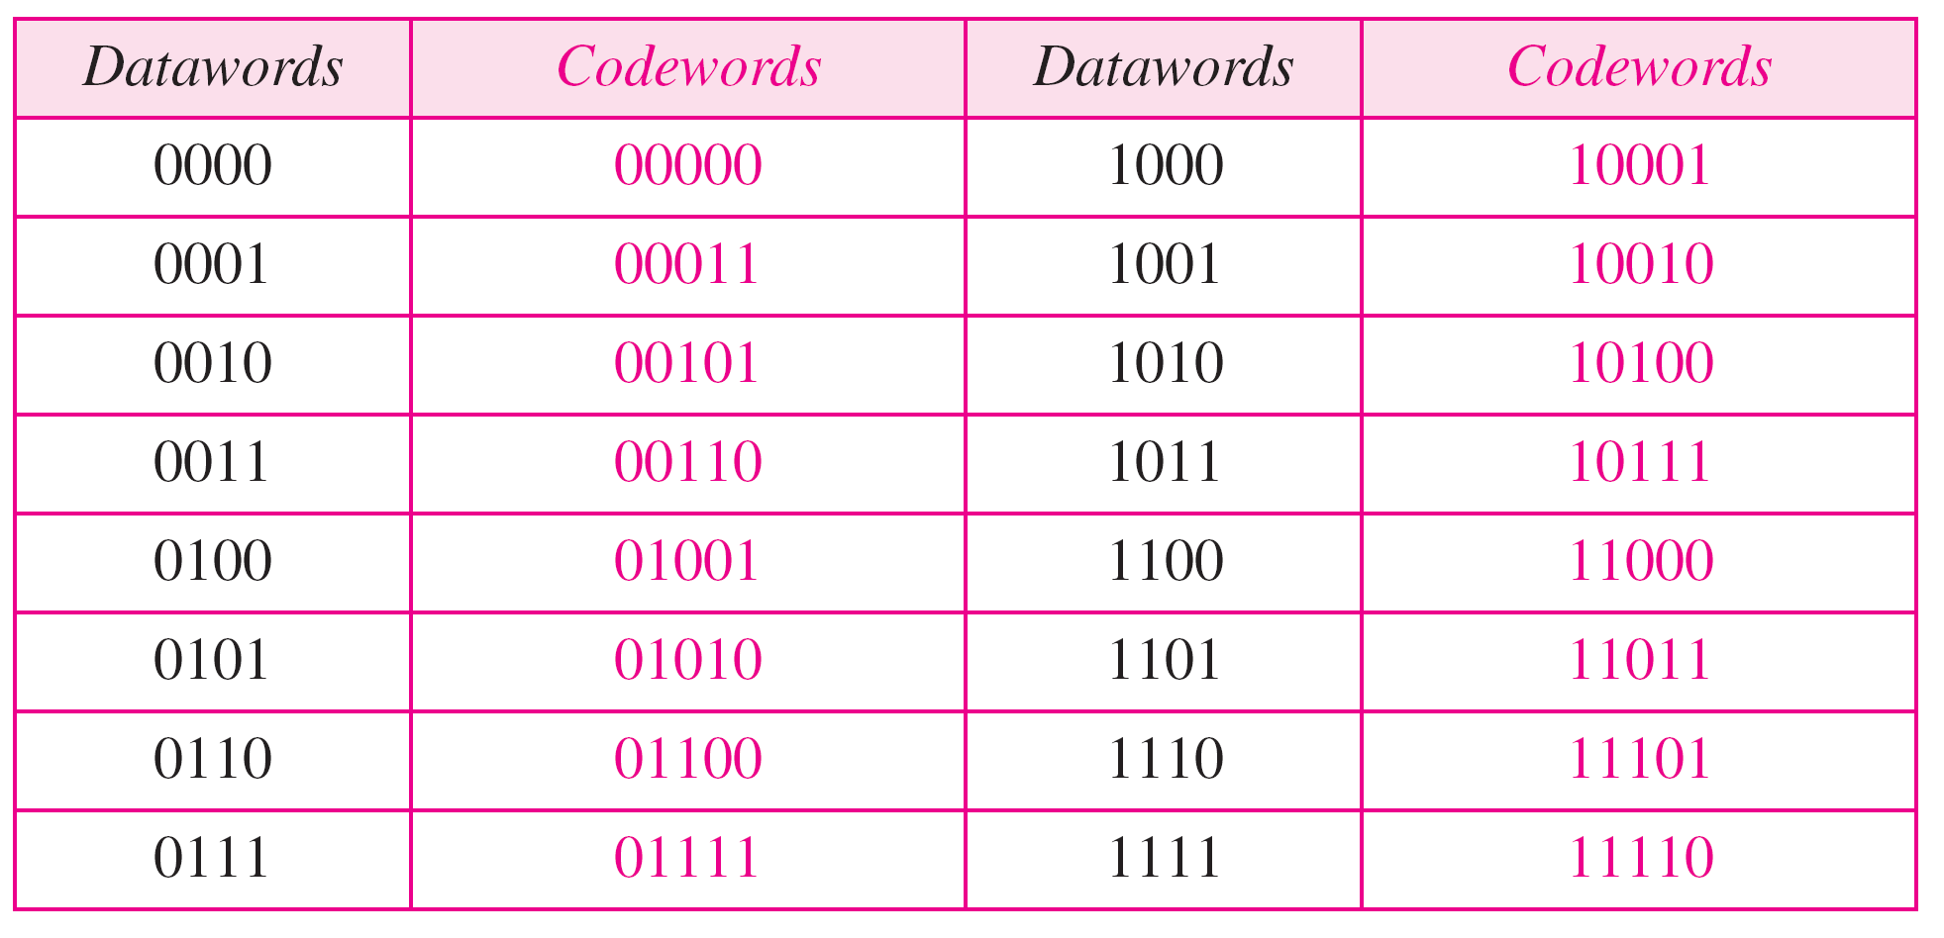
Table 10.3 Simple parity-check code C(5, 4)
10.

Slide 36
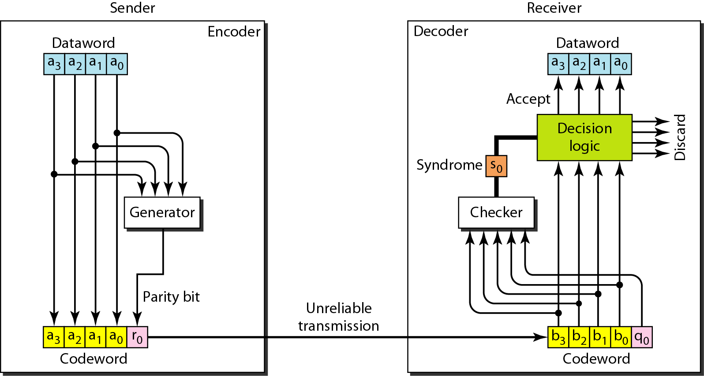
Figure 10.10 Encoder and decoder for simple parity-check code
10.

Slide 37
Example 10.12
Let us look at some transmission scenarios. Assume the sender sends the dataword 1011. The codeword created from this dataword is 10111, which is sent to the receiver. We examine five cases:
1. No error occurs; the received codeword is 10111. The syndrome is 0. The dataword 1011 is created.
2. One single-bit error changes a₁ . The received codeword is 10011. The syndrome is 1. No dataword is created.
3. One single-bit error changes r₀ . The received codeword is 10110. The syndrome is 1. No dataword is created.
10.

Slide 38
Example 10.12 (continued)
4. An error changes r₀ and a second error changes a₃ .
The received codeword is 00110. The syndrome is 0. The dataword 0011 is created at the receiver. Note that
here the dataword is wrongly created due to the
syndrome value.
5. Three bits—a₃, a₂, and a₁—are changed by errors. The received codeword is 01011. The syndrome is 1. The dataword is not created. This shows that the simple parity check, guaranteed to detect one single error, can also find any odd number of errors.
10.

Slide 39
Note
A simple parity-check code can detect an odd number of errors.
10.

Slide 40
10-4 CYCLIC CODES
Cyclic codes are special linear block codes with one extra property. In a cyclic code, if a codeword is cyclically shifted (rotated), the result is another codeword.
Topics discussed in this section:
Cyclic Redundancy Check Polynomials
10.

Slide 41
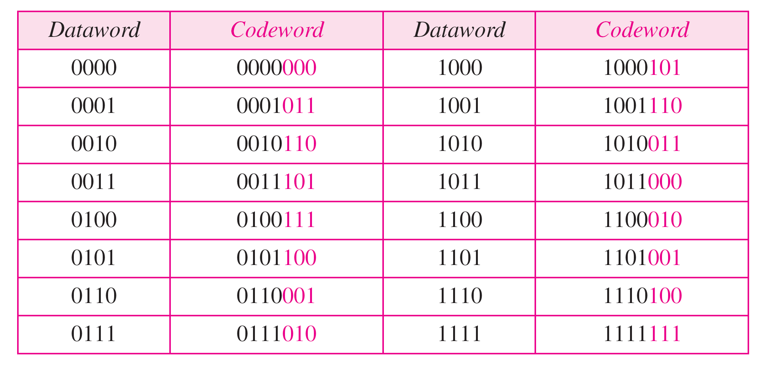
Table 10.6 A CRC code with C(7, 4)
10.

Slide 42
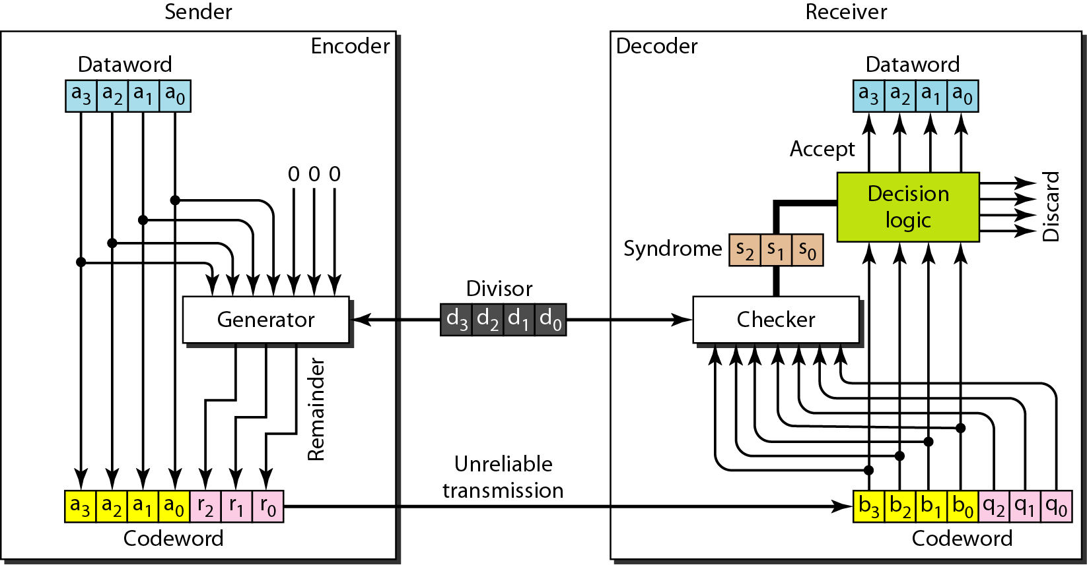
Figure 10.14 CRC encoder and decoder
10.

Slide 43
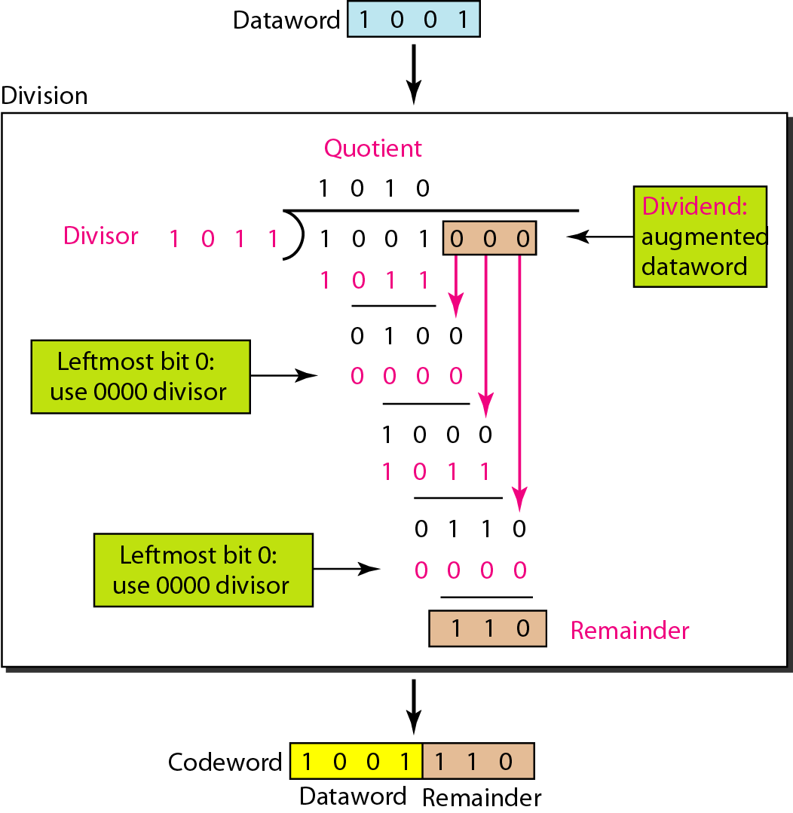
Figure 10.15 Division in CRC encoder
10.

Slide 44
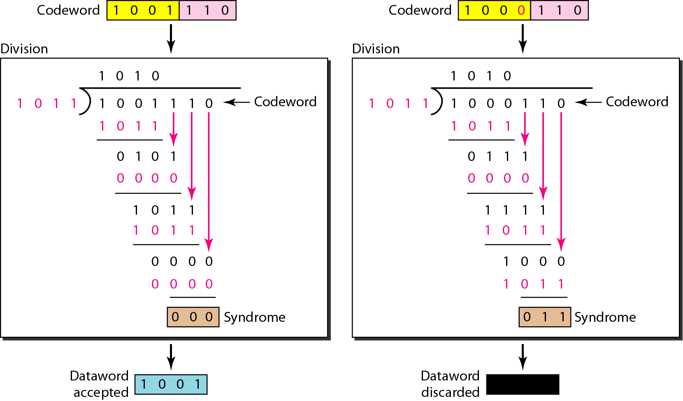
Figure 10.16 Division in the CRC decoder for two cases
10.

Slide 45
Using Polynomials
We can use a polynomial to represent a binary word.
Each bit from right to left is mapped onto a power term.
The rightmost bit represents the “0” power term. The bit next to it the “1” power term, etc.
If the bit is of value zero, the power term is deleted from the expression.

Slide 46
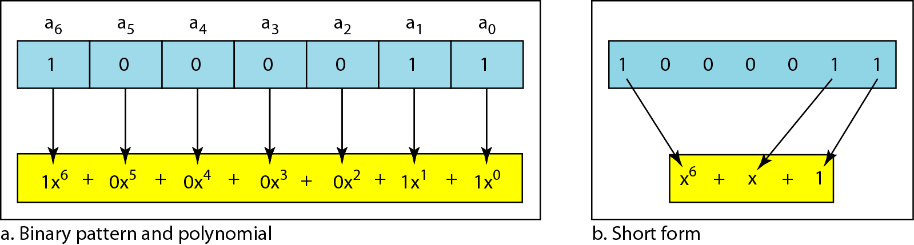
Figure 10.21 A polynomial to represent a binary word
10.

Slide 47
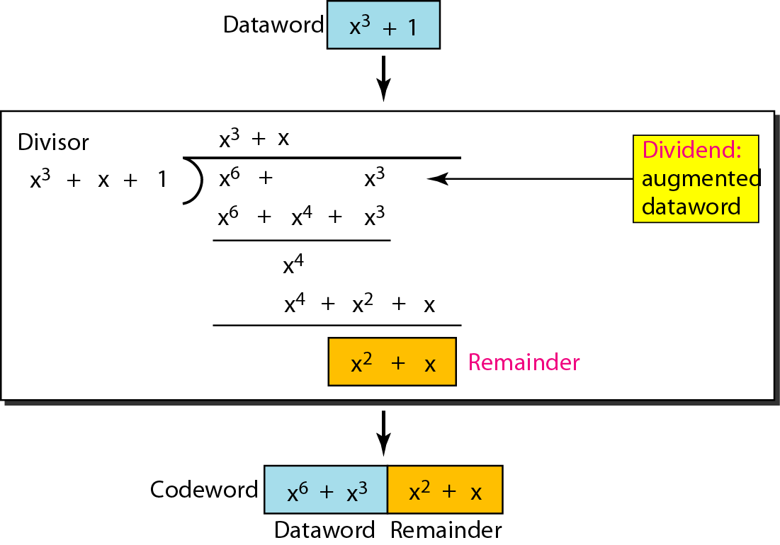
Figure 10.22 CRC division using polynomials
10.

Slide 48
10-5 CHECKSUM
The last error detection method we discuss here is called the checksum. The checksum is used in the Internet by several protocols although not at the data link layer. However, we briefly discuss it here to complete our discussion on error checking
Topics discussed in this section:
Idea One’s Complement Internet Checksum
10.

Slide 49
Example 10.18
Suppose our data is a list of five 4-bit numbers that we want to send to a destination. In addition to sending these numbers, we send the sum of the numbers. For example, if the set of numbers is (7, 11, 12, 0, 6), we send (7, 11, 12, 0, 6, 36), where 36 is the sum of the original numbers. The receiver adds the five numbers and compares the result with the sum. If the two are the same, the receiver assumes no error, accepts the five numbers, and discards the sum. Otherwise, there is an error somewhere and the data are not accepted.
10.

Slide 50
Example 10.19
We can make the job of the receiver easier if we send the negative (complement) of the sum, called the checksum. In this case, we send (7, 11, 12, 0, 6, −36). The receiver can add all the numbers received (including the checksum). If the result is 0, it assumes no error; otherwise, there is an error.
10.

Slide 51
Example 10.20
How can we represent the number 21 in one’s complement arithmetic using only four bits?
Solution
The number 21 in binary is 10101 (it needs five bits). We can wrap the leftmost bit and add it to the four rightmost bits. We have (0101 + 1) = 0110 or 6.
10.

Slide 52
Example 10.21
How can we represent the number −6 in one’s complement arithmetic using only four bits?
Solution
In one’s complement arithmetic, the negative or complement of a number is found by inverting all bits. Positive 6 is 0110; negative 6 is 1001. If we consider only unsigned numbers, this is 9. In other words, the complement of 6 is 9. Another way to find the complement of a number in one’s complement arithmetic is to subtract the number from 2^{n} − 1 (16 − 1 in this case).
10.

Slide 53
Example 10.22
Let us redo Exercise 10.19 using one’s complement arithmetic. Figure 10.24 shows the process at the sender and at the receiver. The sender initializes the checksum to 0 and adds all data items and the checksum (the checksum is considered as one data item and is shown in color). The result is 36. However, 36 cannot be expressed in 4 bits. The extra two bits are wrapped and added with the sum to create the wrapped sum value 6. In the figure, we have shown the details in binary. The sum is then complemented, resulting in the checksum value 9 (15 − 6 = 9). The sender now sends six data items to the receiver including the checksum 9.
10.

Slide 54
Example 10.22 (continued)
The receiver follows the same procedure as the sender. It adds all data items (including the checksum); the result is 45. The sum is wrapped and becomes 15. The wrapped sum is complemented and becomes 0. Since the value of the checksum is 0, this means that the data is not corrupted. The receiver drops the checksum and keeps the other data items. If the checksum is not zero, the entire packet is dropped.
10.

Slide 55
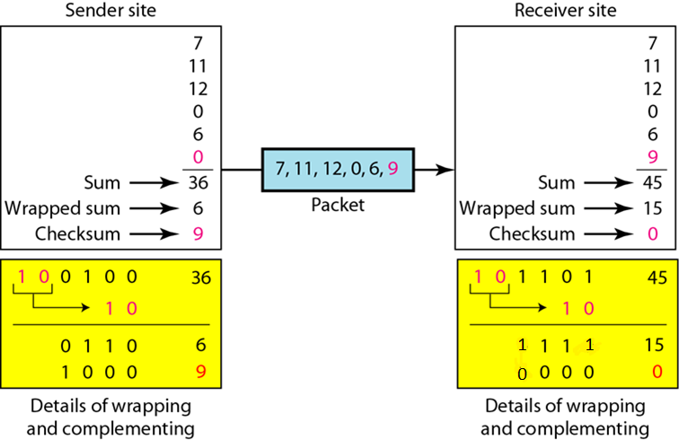
Figure 10.24 Example 10.22
1
10.

Slide 56
Internet Checksum
Traditionally, the Internet has used a 16-bit checksum. The sender and the receiver follow the steps depicted in below.
The sender or the receiver uses five steps.
10.

Slide 57
Note
Sender site:
1. The message is divided into 16-bit words.
2. The value of the checksum word is set to 0.
3. All words including the checksum are added using one’s complement addition.
4. The sum is complemented and becomes the checksum.
5. The checksum is sent with the data.
10.

Slide 58
Note
Receiver site:
1. The message (including checksum) is divided into 16-bit words.
2. All words are added using one’s complement addition.
3. The sum is complemented and becomes the new checksum.
4. If the value of checksum is 0, the message is accepted; otherwise, it is rejected.
10.

Slide 59
Book Reference
Data Communications and Networking 5th Edition- Behrouz A. Forouzan

